Slide 1
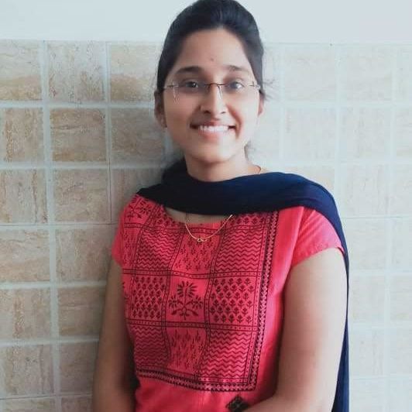


Praveena Palla
Analyst/Software Engineer
Bachelor of Technology
Computer Science : 2017 - 2021
Skills Java 8 /J2EE
Spring Boot
Spring MVC
JPA Crud
Bootstrap
Backend
Spring Boot/Spring Security
REST-API
NodeJS
Database
SQL database – MySQL
Web Technologies
HTML5
CSS3
Javascript
AddOns
Github
Maven
Postman
Additional Details
Leadership
Quick Learner
Team management
Bangalore
Praveena.palla@capgemini.com
+91 8179113620
A4
Hands on experience in creating web application with Spring Boot, Spring Security, Data JPA.
Hands on experience in creating traditional and reactive application with Visual Basic.
Ready to learn new technologies and implement them to further improve my knowledge.
Eager to work in a team of dedicated people and serve a key role in the enhancement and development of the project.
Has working knowledge on Angular and Java Development using Spring framework on an intermediate level.
https://github.com/praveenapalla/Resume
Certified AWS Cloud Practitioner
Employee Management System Application
Completed end to end case study of Employee Management System where both the frontend and backend are connected using JDBC Spring boot to postman and PostgreSQL, in which the user can perform the following operations named login, view, update, and delete the employee data.

